Slide 1







NguyenTanHoang
NguyenCongQuy
TENSORFLOW
OBJECT DETECTION API

Slide 2



1. INTRODUCTION TO OBJECT DETECTION
2. OVERVIEW OF TENSORFLOW OBJECT DETECTION API
3. OBJECT DETECTION MODELS AND ARCHITECTURES
4. TRAINING AN OBJECT DETECTION MODEL WITH TENSORFLOW OBJECT DETECTION API
5. EVALUATION AND PERFORMANCE METRICS
6. DEPLOYMENT AND INFERENCE
7. PRACTICE

Slide 3

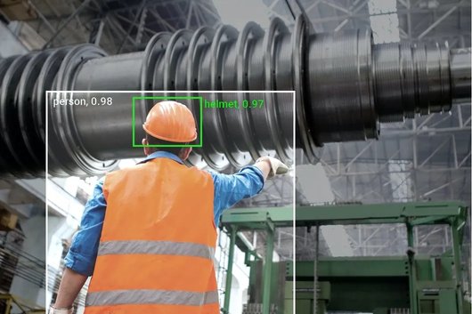
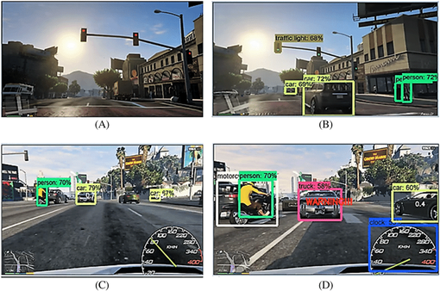
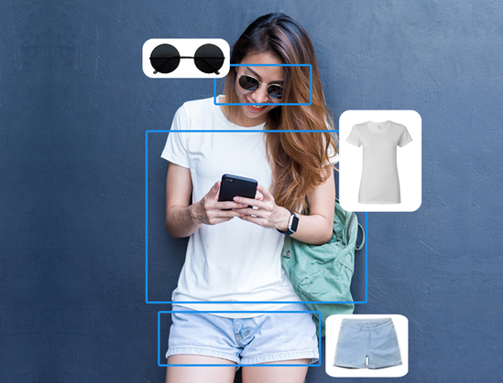
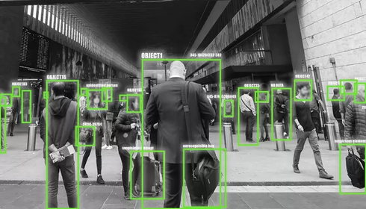
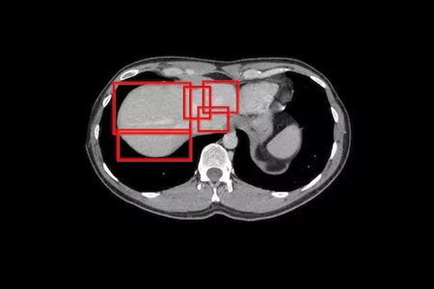
1. INTRODUCTION TO OBJECT DETECTION
Object detection is a technique in the field of computer vision, it is used to detect and determine the position of objects in an image or video.
R-CNN, Fast R-CNN, Faster R-CNN, SSD, YOLO và RetinaNet
Industrial and manufacturing automation
Car automation
E-commerce and marketing
Security and surveillance
Medical and healthcare

Slide 4


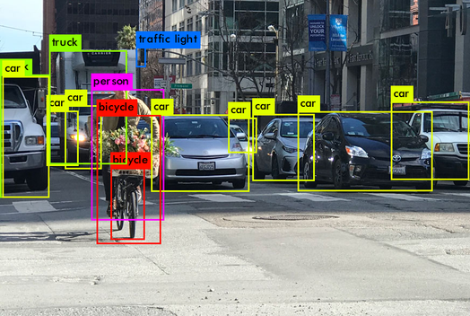


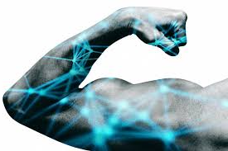

2. OVERVIEW OF TENSORFLOW OBJECT DETECTION API
Key features
Allows users to easily build high-quality object detection models without the need for in-depth knowledge of Machine Learning.
Reduce the time and cost of training new object detection models.
Increased reusability and sharing of object detection models between different projects.
Improve object detection performance by customizing lossy functions and hyperparameters.
TensorFlow Object Detection API is a powerful tool for object detection in images and videos.
This API allows users to build high-quality object detection models and deploy them across platforms

Slide 5
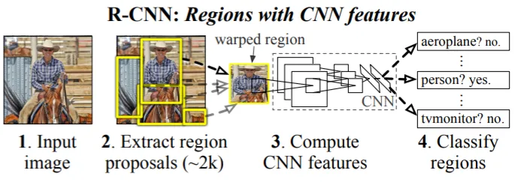
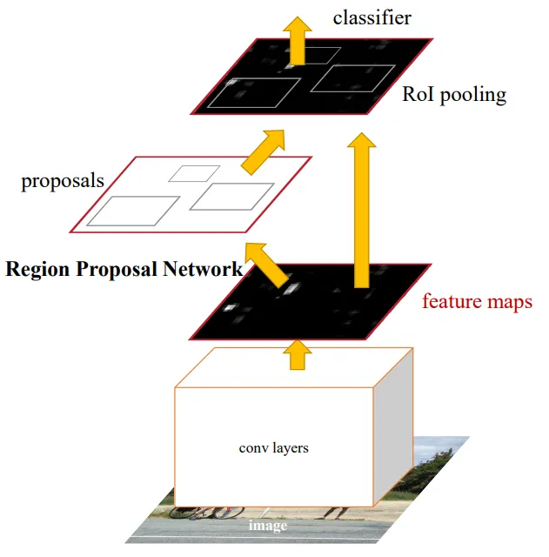
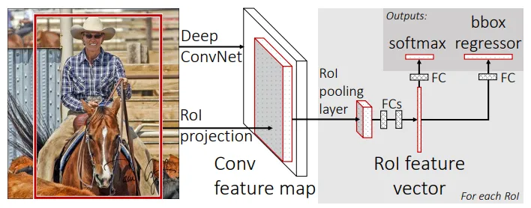
3. OBJECT DETECTION MODELS AND ARCHITECTURES
Two-stage detectors:
The model is used to extract regions of objects, and a second model is used to classify and further refine the localization of the object
Faster R-CNN
Fast R-CNN

Slide 6
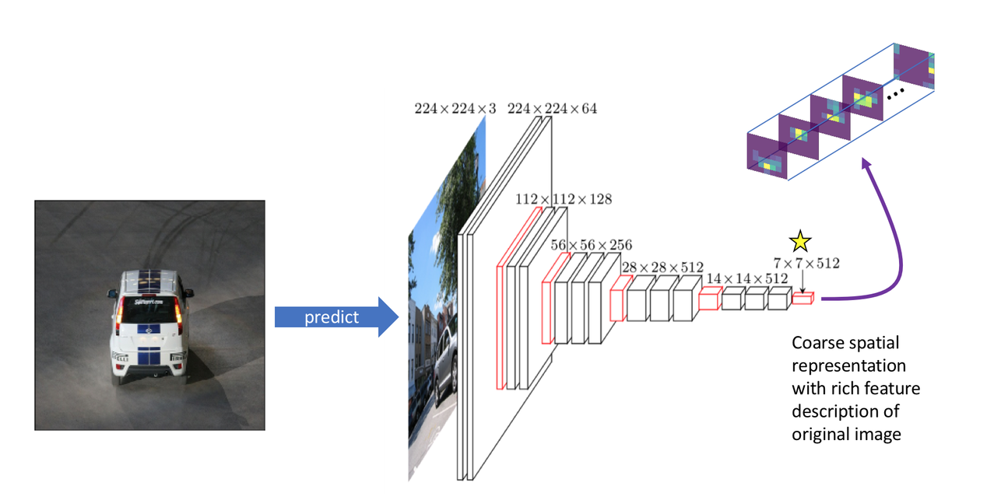
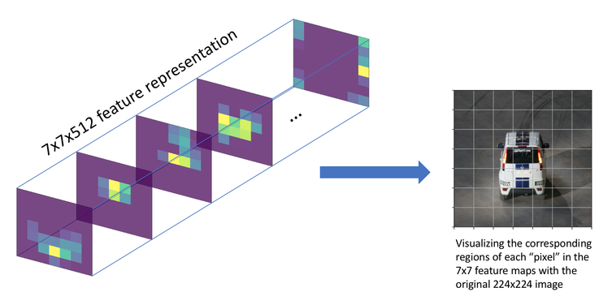
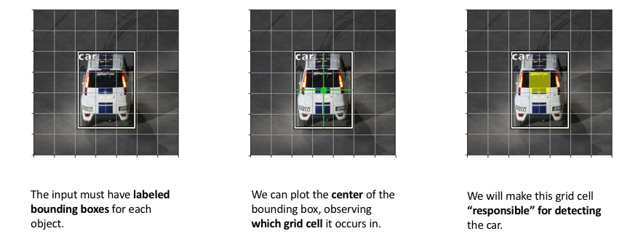
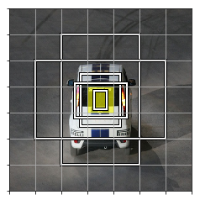
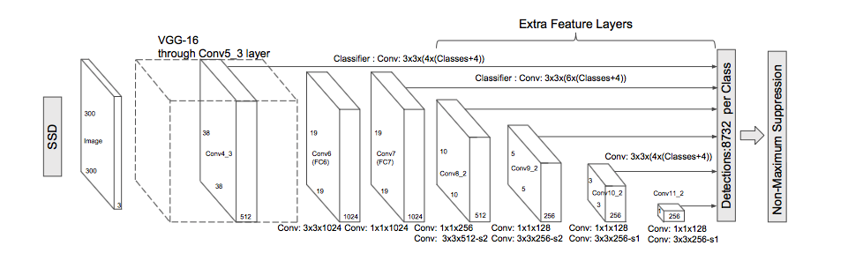
3. OBJECT DETECTION MODELS AND ARCHITECTURES
One-stage detectors:
YOLO: You Only Look Once
SSD: Single Shot Detection

Slide 7
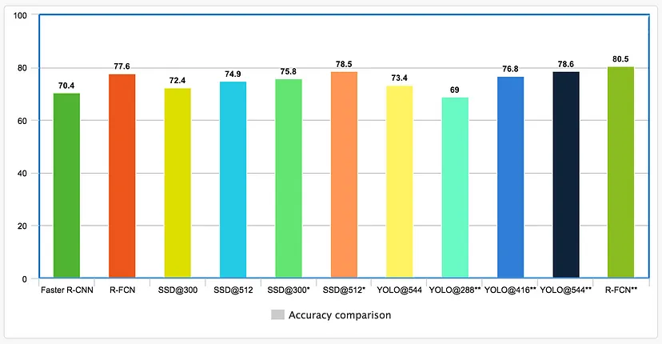
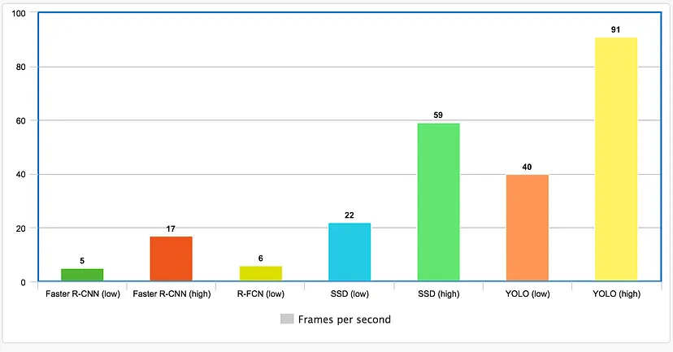
3. OBJECT DETECTION MODELS AND ARCHITECTURES
Jonathan Hui "Object detection: speed and accuracy comparison (Faster R-CNN, R-FCN, SSD, FPN, RetinaNet and YOLOv3)"
Two stages generally have higher accuracy but slower speeds than one stage. Whereas a stage is usually faster, but can have less accuracy.

Slide 8
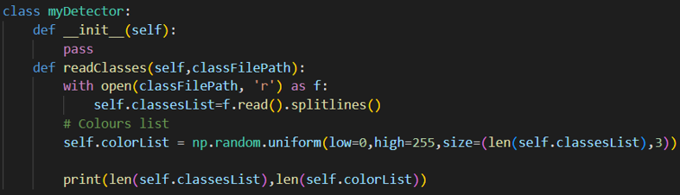
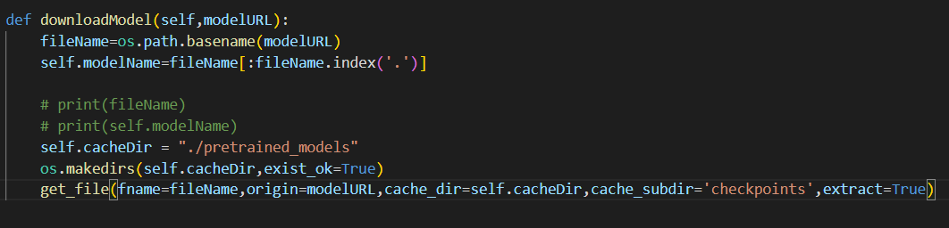
4. TRAINING AN OBJECT DETECTION MODEL WITH TENSORFLOW OBJECT DETECTION API
Read coco.names ( labelling file)
Download pre-trained models at Tensorflow object detection API

Slide 9
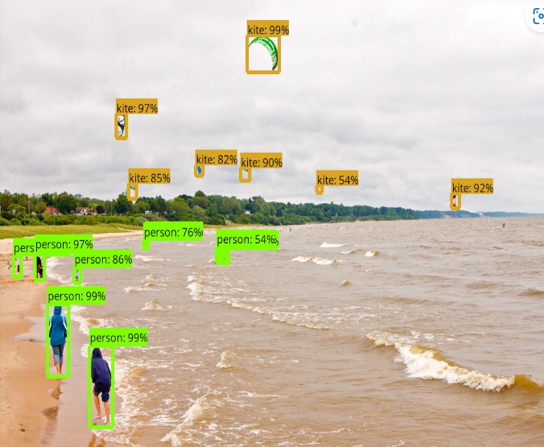
4. TRAINING AN OBJECT DETECTION MODEL WITH TENSORFLOW OBJECT DETECTION API
Implement models to predict several Images
In this example, I used EfficientDet – a recent family of SOTA models discovered with the help of Neural Architecture Search

Slide 10
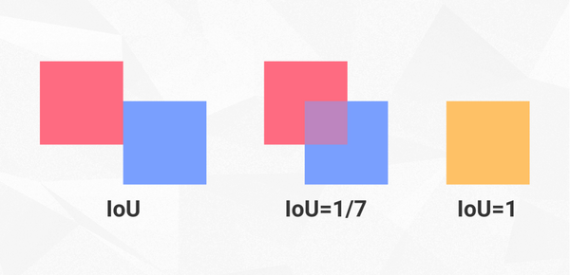
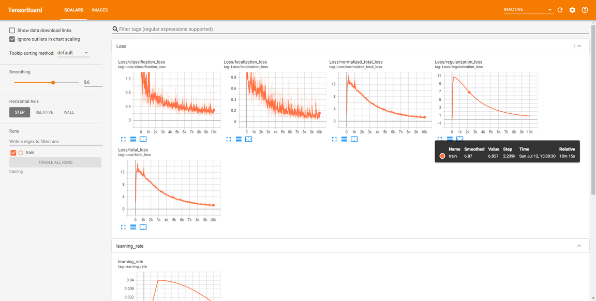
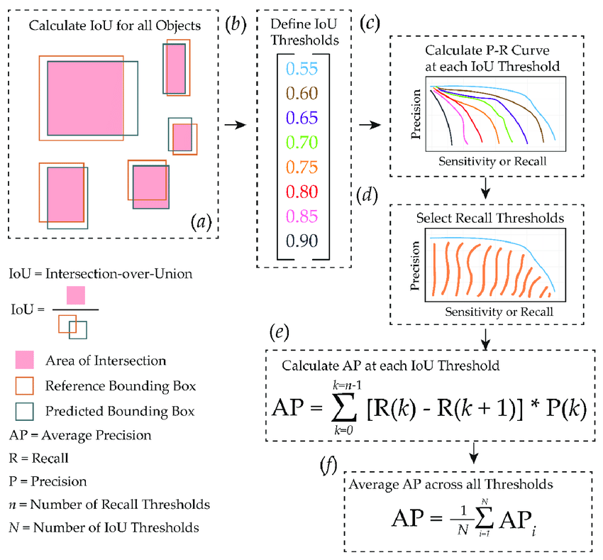
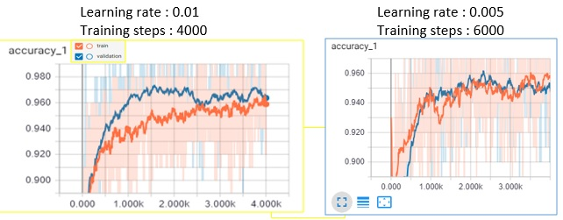
5. EVALUATION AND PERFORMANCE METRICS
Intersection over Union (IoU)
Loss
Recall (Sensitivity)
Precision (Accuracy)

Slide 11
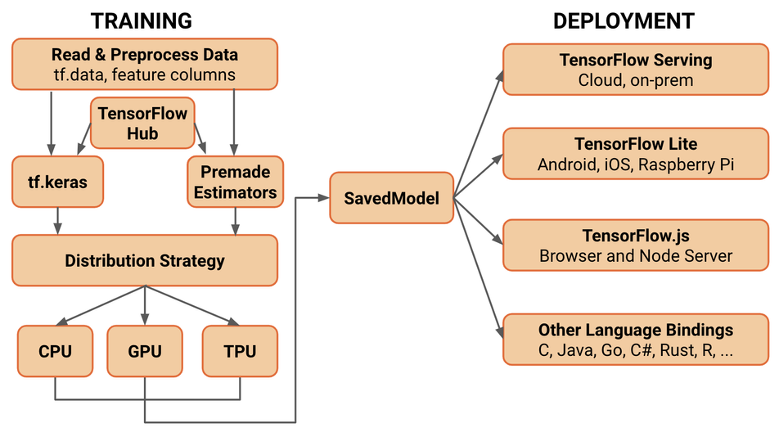
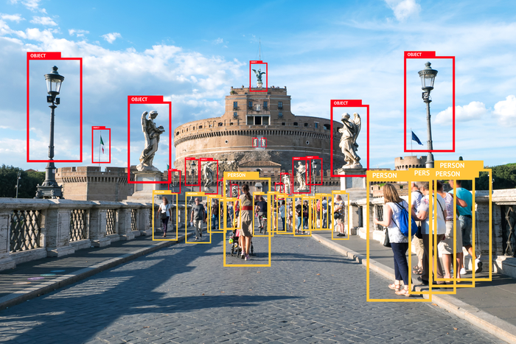



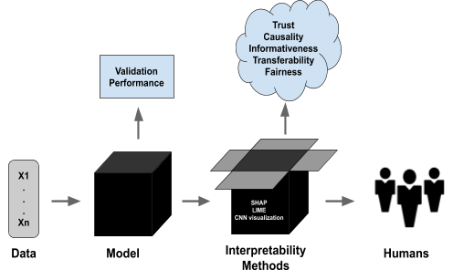
6. DEPLOYMENT AND INFERENCE
Exporting and deploying trained models
Object detection in real-time using pre-trained models
Challenges and limitations of deploying object detection models
Acquiring high-quality data large enough
Some object recognition models have low interpretability
Audience diversity
Reducing accuracy can lead to erroneous results and affect application performance.

Slide 12
7. PRACTICE
7.1 Setting up the environment
7.2 Tensorflow Object Detection Zoo
7.3 Tensorflow Object Detection Implementation
7.4 Object Detection with some pre-trained models

Slide 13



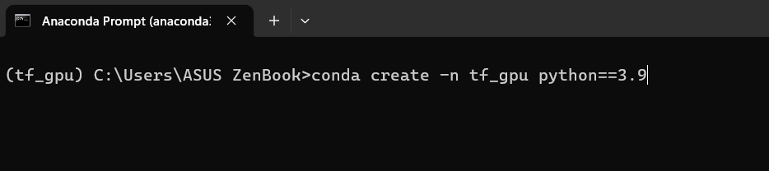
7.1 Setting up the environment
Tool Requirements
Anaconda
Visual Studio Code
Python
Create the working environment

Slide 14
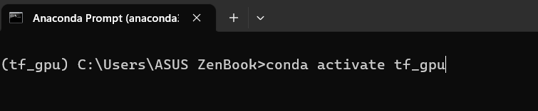
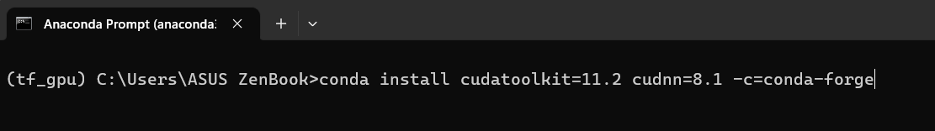
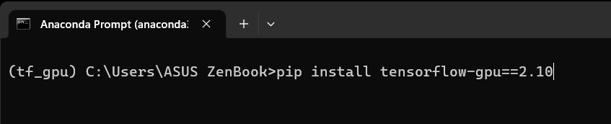
7.1 Setting up the environment
Activate the working environment
Download CUDA and cuDNN
Download GPU

Slide 15
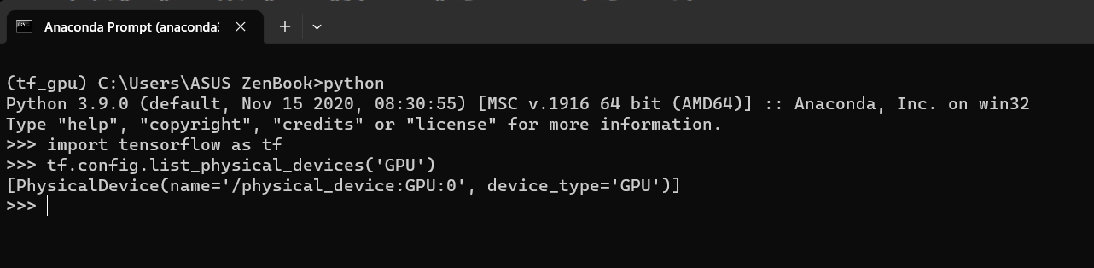
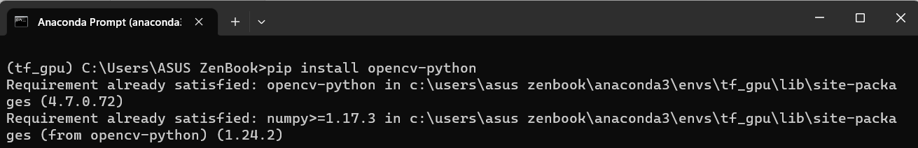
7.1 Setting up the environment
Check GPU working
Install OpenCV

Slide 16
7. PRACTICE
7.2 Tensorflow Object Detection Zoo
models/tf2_detection_zoo.md at master · tensorflow/models · GitHub

Slide 17
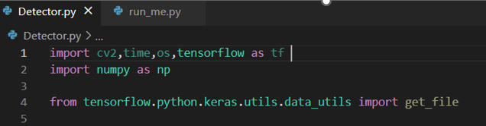
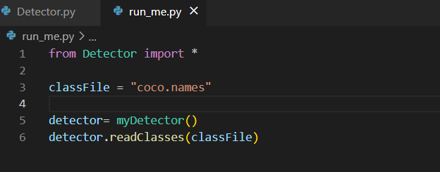
7.3 Tensorflow Object Detection Implementaion
Install library
Define first method ( readClasses)

Slide 18
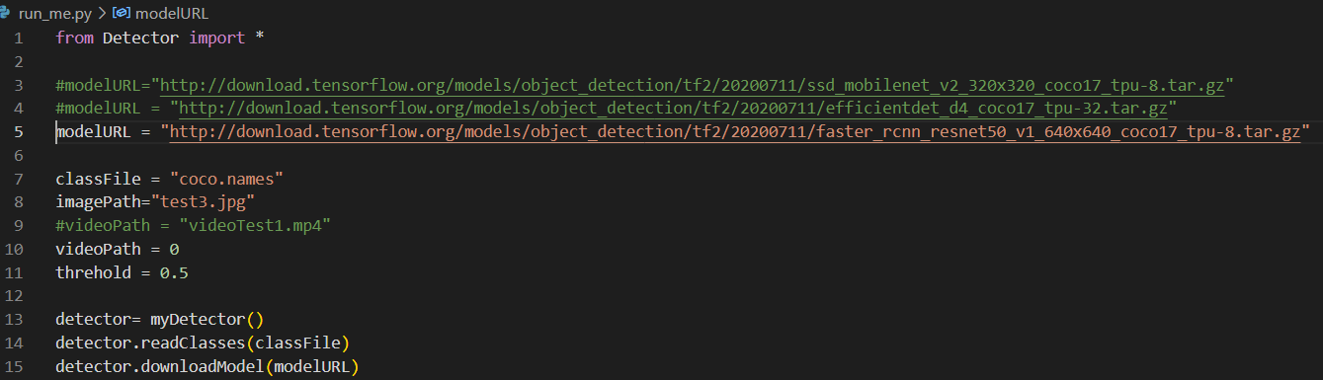
7.3 Tensorflow Object Detection Implementaion
Define downloadModel Method

Slide 19
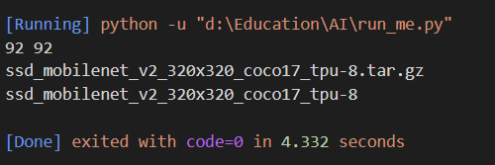
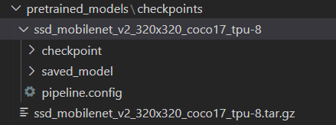
7.3 Tensorflow Object Detection Implementation
Result

Slide 20
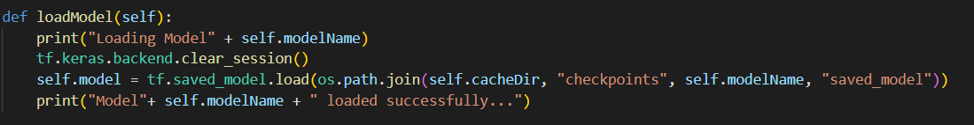
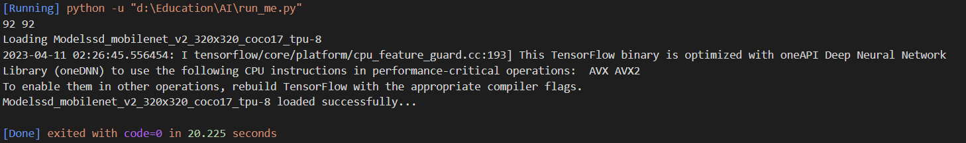
7.3 Tensorflow Object Detection Implementation
Define loadModel Method

Slide 21
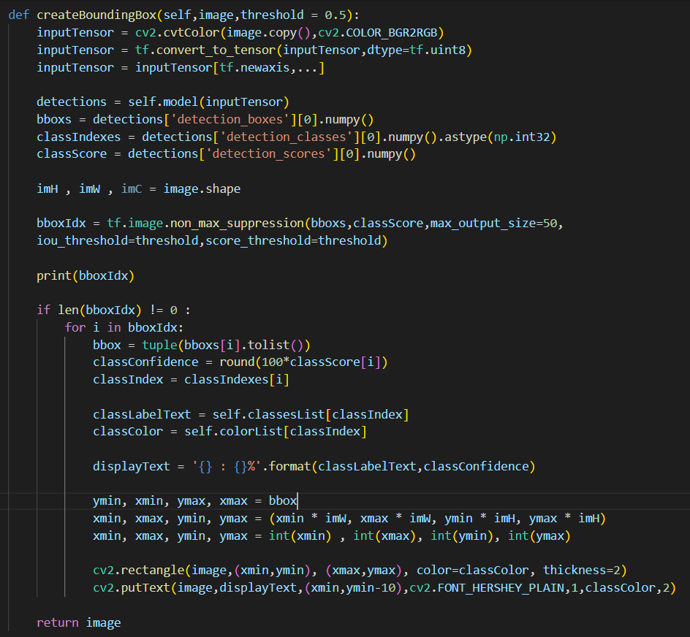
7.3 Tensorflow Object Detection Implementation
Define createBoundingBox Method

Slide 22
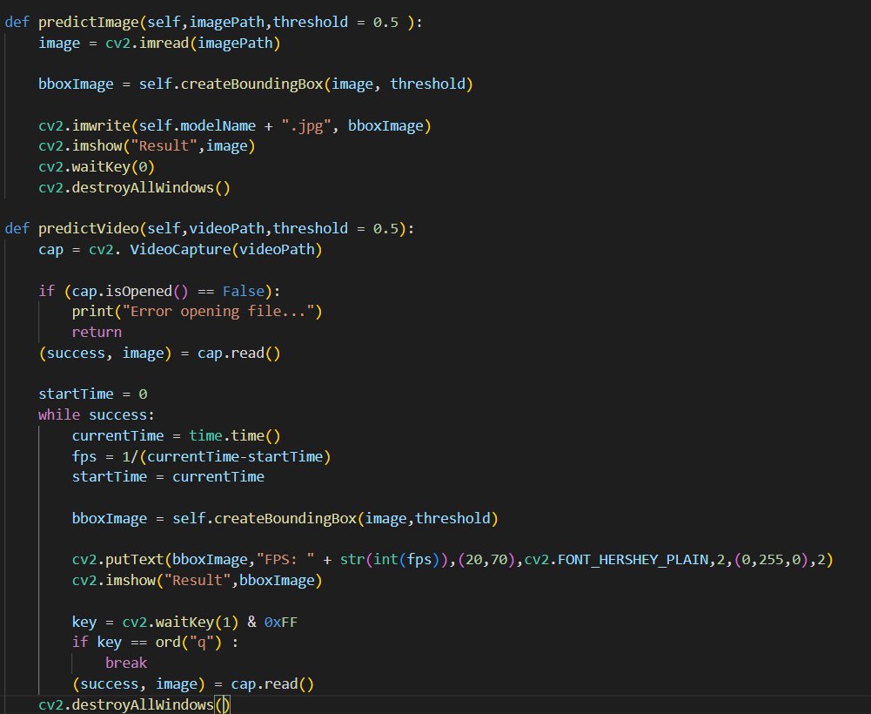
7.3 Tensorflow Object Detection Implementation
Define predictImage and predictVideo Method

Slide 23
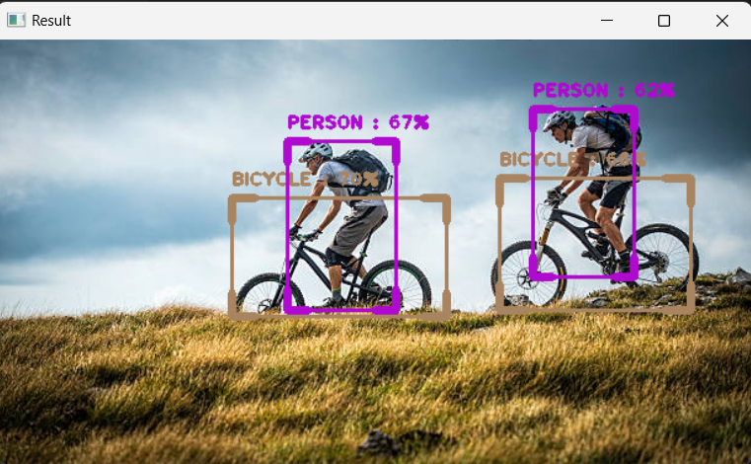
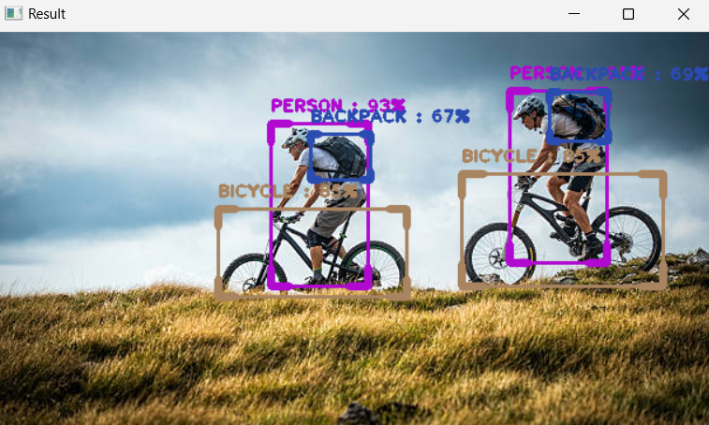
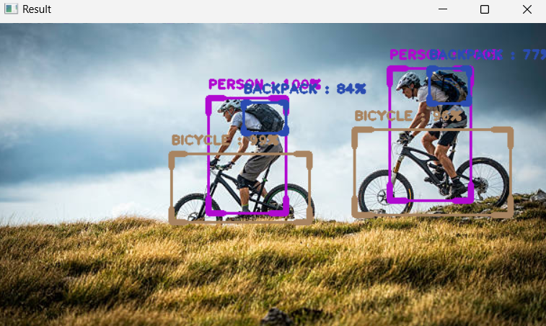
7.4 Object Detection with some pre-trained models
SSD MobileNet
EfficientNet
FasterRCNN

Slide 24
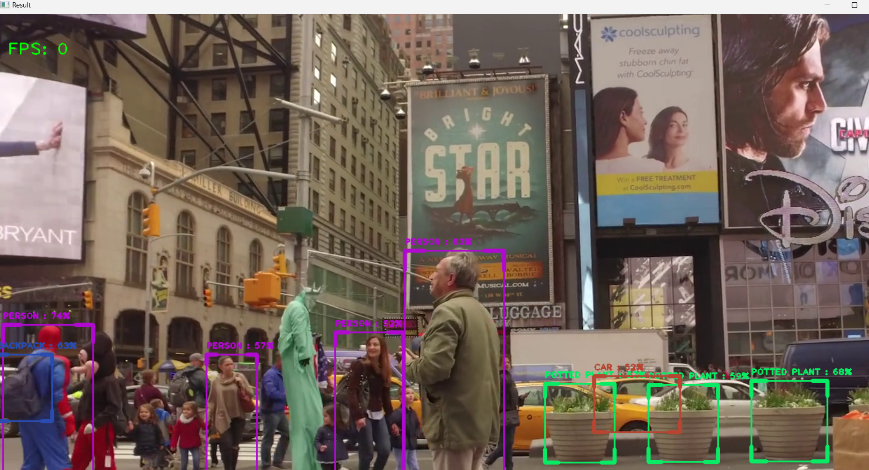
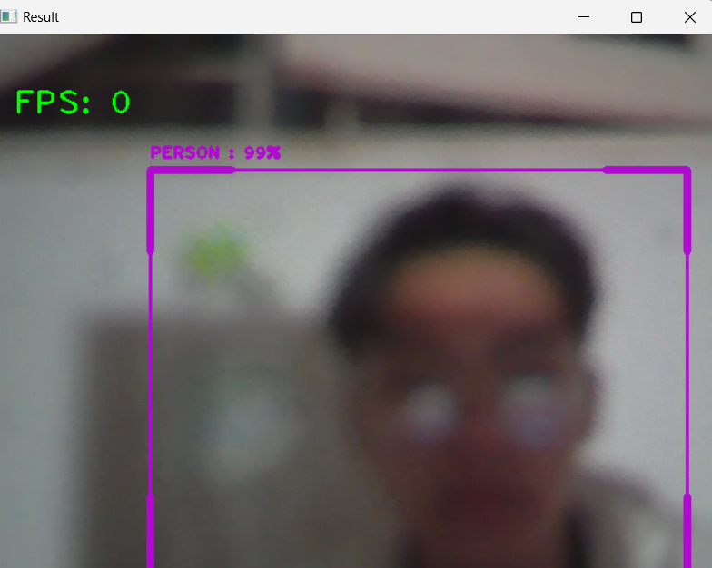
7.4 Object Detection with some pre-trained models
EfficientNet on Video
FasterRCNN on webcam

Slide 25


NguyenTanHoang
NguyenCongQuy
THANK YOU
FOR YOUR ATTENTION

